Slide 1

Administrative Charging Committee
FY 2026 Budget Overview
Budget & Policy Analysis Division
Malcolm Moody, Policy Analyst
May 1, 2025

Slide 2
Agenda
Department Overview
Strategic Focus
General Fund Overview
Grant Funds & Staffing
Agency Budget Summary
Legislative Impact
Staff Comments

Slide 3
Administrative Charging Committee
Mission
Seeks to improve police customer service and community responsiveness to citizens’ complaints of police misconduct through the establishment of effective independent oversight of the police disciplinary process and its outcomes.
Administrative Charging Committee
Legal Counsel
Staff
Support Staff
Kelvin Davall, Chair
Core Services
Work with all law enforcement agencies in the County to improve matters of policing
Receive complaints of police misconduct filed by members of the public and transfer them to the appropriate law enforcement agency to commence investigations
Evaluate outcomes of investigations of alleged police misconduct conducted by law enforcement agencies and reviewed by the administrative oversight committee
Produce annual reports for the County’s governing authority and the public
Notes:
Speaker Notes
Source: Budget Book pg. 243
This slide covers the Mission, Structure, and Core Services of the ACC. All of this can be found in the Budget Book on pg. 243
On the next slide…

Slide 4
Strategic Focus FY 2026
Working efficiently with limited resources to provide quality legal services.
Attempting to reduce the amount and number of adverse decisions resulting from litigation against the County by monitoring cases to identify trends and addressing problems with the applicable agency.
Meeting with department leadership.
Continuing to improve efficiency in responding to public information requests and moving forward with the development of open meetings and trainings for boards and commissions.
Notes:
Speaker Notes
Budget Book pg. 244
This covers the strategic focus of the ACC, which is found on pg. 244 of the Budget Book
Next is

Slide 5
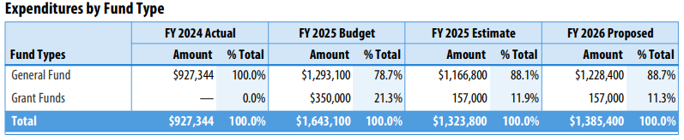
FY 2026 Budget Summary
Proposed FY 2026
$1.4 Million
Decrease -$257,700 or -15.7%
Notes:
Speaker Notes:
Source: Budget Book pg. 244
A slide focusing on the budget summary. Here you will see a chart displaying the expenditures by Fund Type from FY 2024 – FY 2026 Proposed
Below that is the total proposed budget for FY 2026, which is at $1.4 million and decreased by $257,700 compared to the FY 2025 Budget
Next..

Slide 6
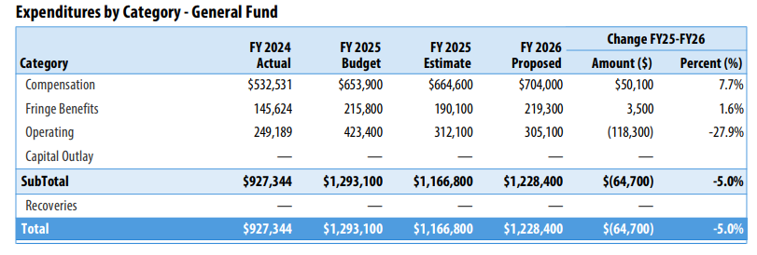
General funds
Proposed FY 2026
$1.2 Million
Decrease $64,700 or -5.0%
+$704,000 COMPENSATION
Mandated salary adjustments
Fund eight (8) FT position
$50,100 Increase in compensation
$305,100 OPERATING
Due to revised projection calculation for trial staff and case hearings
+$219,300 Fringe Benefits
Increase to align with compensation salary adjustments
Supports trial preparation, Trial Board Judges, stipends, and community awareness events
Decrease in Fringe Benefit rate from 33.0% to 31.2%
$118.3K Decrease or -27.9%
Notes:
Speaker Notes:
Source: FY 2026 Budget Book pg. 247
Is a slide on General Funds for the ACC. Here you see the expenditures in the General Fund for the ACC.
For FY 2026 the proposed amount is at $1.2 million, with a decrease of $64,700
The other charts showcase the different categories in the general fund. Only Operating expenses saw a decrease.
Can find this on pg. 247 of the Budget Book
Next…

Slide 7
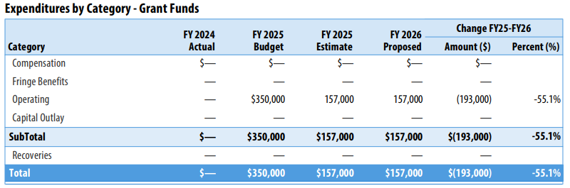

GRANT FUNDS & STAFFING
Grant Funding FY 2026
$157,000 a decrease of -$193,000 or -55.1%
Due to reductions in existing Community Grant Program Fund and ACC, Community and Transparency Grant
+$157,000 Operating
Used to support program operational expenses
STAFFING
FULL TIME CIVILIAN
Unchanged
8 Positions
Notes:
Speaker Notes:
Source: FY 2026 Budget Book pg. 248
This slide covers grant funds and staffing. On the left side there is explanation of the reduction in grant funding for FY 2026 along with the reasoning
On the right side is a chart on the operating budget and staffing for the ACC which remains unchanged at 8 positions
Can find this info on pg. 248 of the Budget Book

Slide 8
Legislative Impact
Impact
HB0670 - Maryland Police Accountability Act of 2021 - Police Discipline and Law Enforcement Programs and Procedures
CB-21-2022
Requires additional personnel to meet statutory review periods for:
Established PAB and ACC in the County
Notes:
Speaker Notes
- This slide covers pieces of legislation have passed and will have a large impact on the ACC
CB-21-2022 established the PAB and ACC after the MD Police Accountability Act of 2021 was passed
Both will require additional personnel
- FRR Q.10, p.5

Slide 9
Legislative Impact Continued
Positive Fiscal Impact:
HB0186 – Public Safety – Police Accountability – Police Discipline – Trial Board Composition
Minimal Fiscal Impact:
HB0122 – Public Safety – Police Accountability – Police Officer Complaint
HB0238 – Public Safety – Police Accountability – Time Limit for Filing Administrative Charges
Negative Fiscal Impact:
HB0139 – Public Safety – Police Accountability – Deadline for Completion of Investigation
Notes:
Speaker Notes
Overview of fiscal impact of legislation that was considered in Maryland General Assembly.
None of these passed both chambers.
- FRR Q.24, p.11

Slide 10
Staff Comments
Responsive Agencies
Tracking
Capital Improvement request made for a full-service case management system, which would allow citizens to track the status of their complaints
Additional personnel needed to keep up with increasing workload demands
The following Police Departments have been particularly responsive during investigations:
Staffing
Greenbelt
Bowie
Laurel
Seat Pleasant
Notes:
Here I will end with staff comments about the ACC
There was a Capital Improvement request to get a full-service case management system to allow citizens to track the status of complaints
Additional staff is needed to keep up with workload
The agencies/police departments listed below have been particularly responsive during investigations

Slide 11




THANK
YOU
Malcolm Moody
+1 (301) 952-5431
mmoody@co.pg.md.us
Notes:
This concludes my presentation to the Committee. Thank you.

