Slide 1
Prince George’s County Climate Action Plan
December Climate Action Commission Meeting
December 18, 2020

Slide 2
Agenda
Establishing Work Groups
Establish Guiding Principles
County GHG Inventory and Business as Usual Forecast: Inputs & Results
Climate Risk and Vulnerability Assessment Process
Stakeholder Engagement Process
Discussion & Next Steps

Slide 3
Establishing Work Groups
Joe Gill - DoE

Slide 4
Process for Establishing Work Group Membership
Commissioners responded to survey following November Commission meeting ranking Work Group preference
Considered two factors in establishing Work Groups:
  Representation
  Membership

Slide 5
Adaptation & Resiliency Work Group Membership
Intended Commission Role (CR-07-2020) | Work Group Member
MWCOG | MWCOG-Stephen Walz replacement
UMD | Scott Lupin
DPW&T | Liz Miller
M-NCPPC | Kim Finch
DPIE | Rey DeGuzman
DoE | Joe Gill
Health Officer | Evelyn Hoban
Chamber of Commerce-Energy Production or Transmission | Brian Smith-Alternate

Slide 6
Mitigation Work Group Membership
Intended Commission Role (CR-07-2020) | Work Group Member
Non-profit environmental | Gary Allen
Chamber of Commerce-Energy Production or Transmission | William Ellis
OCS | Erica Bannerman
Chamber of Commerce-Energy Production or Transmission | Brian Smith - Alternate
Non-profit environmental | Dr. Henry Cole
County Council | Council Member Dernoga
Bowie State University | Dr. Alan Anderson

Slide 7
Education & Outreach Work Group Membership
Intended Commission Role (CR-07-2020) | Work Group Member
Non-profit environmental | Dr. Janet Gingold
Public Schools | Donald Belle
County Council | Council Member Dernoga
PGC Municipal Association | Mayor Bryd
DPW&T | Andrea Lasker - Alternate

Slide 8
Work Groups: Next Steps
The first meeting of each Work Group will occur in January at a date and time established by the members.
DoE staff and Cadmus will assist in scheduling and facilitating meeting discussion.

Slide 9
Establishing Guiding Principles
Ben Butterworth – Cadmus Group

Slide 10
Establishing Guiding Principles
Why Guiding Principles?
  Central to the vision of the CAP
  Help to guide Commission through decisions
  Inform list of initial actions for consideration
  In collaboration with Work Groups, will be used to refine & prioritize actions
Goal of today’s Commission meeting
  Arrive at consensus on 4-5 Guiding Principles

Slide 11
Establishing Guiding Principles cont.
Brainstorm
Long List
Refine List Using Guiding Principles
Establish Top Priority Actions
“Master List”
“Priority List”
Master List
Provides a record of the complete list of actions brainstormed by Commissioners and community members
Priority List
Provides a manageable number of actions that have a direct and feasible path towards implementation

Slide 12
Establishing Guiding Principles cont.
Future opportunities to refine Guiding Principles if needed, but important to establish initial framework
County staff will be requesting input on the Guiding Principles from community members at the first Community Meeting to ensure that the opinions of the community are fully considered

Slide 13
Potential Guiding Principles
Actionable:
Can the county government take the action? Can it require or influence other parties (governments, businesses) to take the action?
Ambitious:
Is the action far-reaching?
Comprehensive and Integrated:
Does the action fully address the problem?
Equitable:
Is the action fair to all, considering existing disparities?
Evidence-based
Is the action supported by facts and research?

Slide 14
Potential Guiding Principles cont.
Feasible:
Is the action practicable – technologically, financially, and politically?
Impactful:
How much of a difference will the action make?
Inclusive:
Does the action leave anyone out?
Timing:
Can the action be taken within a reasonable time frame?
Transparent and Verifiable:
Can the success of the action be openly measured?

Slide 15
Establishing Guiding Principles: Discussion
Actionable | Feasible
Ambitious | Impactful
Comprehensive & Integrated | Inclusive
Equitable | Timing
Evidence-based | Transparent & Verifiable

Slide 16


Prince George’s County GHG Inventory and BAU –Inputs & Results
Metropolitan Washington Council of Governments
Tim Masters, Environmental Planner

Slide 17
GHG Inventory
Base Year and Historical
  2005 and 2018
Methodology (documentation available)
Results
GHG Contribution Analysis
Key Takeaways
  County is 15% of the COG region’s GHG emissions
  Transportation and Energy for Buildings largest sources
  Biggest impacts to date - Cleaning the electric grid and cleaner vehicle fleet

Slide 18
Inventory Background
COG prepares GHG emissions community-scale inventories for all 24 COG local government members
Compliant with standards
  U.S. Communities Protocol for Accounting and Reporting Greenhouse Gas Emissions (USCP)
  Global Protocol for Community-Scale Greenhouse Gas Inventories (GPC).
  Global Covenant of Mayors (GCoM)
  CDP
ICLEI ClearPath Tool
Activities-based approach, meaning emissions are calculated based on the result of an activity happening in the community
Emissions presented as million metric tons of carbon dioxide equivalent or MMTCO2e

Slide 19
Emissions Sources
Emission sources in COG’s GHG emissions inventories include:
  Built Environment
    Residential and Commercial Energy Use – electricity, natural gas, petroleum fuels
  Transportation and Mobile Emissions
    On- and off-road
  Wastewater Treatment
  Agriculture
  Solid Waste
  Process and Fugitive Emissions

Slide 20
County and Regional Emissions
COUNTY
Total: 9.51 MMTCO2e
Transportation and Mobile Emissions
  48% of emissions
Commercial Energy
  22% of emissions
Residential Energy
  23% of emissions
Others
  Process and Fugitive Emissions, Solid Waste, Agriculture, and Wastewater Treatment - 7% of emissions
REGIONAL
Total: 62.6 MMTCO2e
Transportation and Mobile Emissions
  40% of emissions
Commercial Energy
  30% of emissions
Residential Energy
  22% of emissions
Others
  Process and Fugitive Emissions, Solid Waste, Agriculture, and Wastewater Treatment - 8% of emissions

Slide 21
Change in Prince George’s County GHG Emissions between 2005-2018
Despite 9% growth in population, community-wide GHG emissions decreased by over 15% between 2005 and 2018
  11.18 MMTCO₂e in 2005 to 9.51 MMTCO₂e in 2018
Per capita emissions decreased 22% between 2005 and 2018
  13.49 MTCO₂e in 2005 to 10.49 MTCO₂e in 2018

Slide 22
15% decrease in emissions between 2005 and 2018

Slide 24
Prince George's County 2005 vs. 2018 GHG Inventory Sector Shares
Decreasing Share of Total
  Energy 53% → 45%
Increasing Share of Total
  Transport 43% → 48%
  Process & Fugitive Emissions 3% → 6%
11.2 MMTCO2e
9.5 MMTCO2e

Slide 25
Prince George's County 2005 vs. 2018 Building Emissions by Fuel Type
Decreasing Share of Buildings Total Emissions
  Electricity 71% → 60%
Increasing Share of Buildings Total Emissions
  Natural Gas 26% → 37%

Slide 26
Impact of Cleaner Grid
Electricity consumption decreased 3%
Electricity emissions decreased 64%
Changing electricity fuel mix – greater use of natural gas and growth in renewables

Slide 27
Impact of Cleaner Grid and Efficiency
Total commercial square footage increased 15%
Commercial kWh per square foot decreased 15%
This resulted in a 39% decrease in commercial electricity emissions, despite increasing commercial square footage

Slide 28
Impact of Cleaner Vehicles
VMT increased 8%
Vehicle Emissions decreased 1%
Greater fuel efficiency resulted in a 10% decrease in on road emissions per mile

Slide 29
Prince George’s County Business-as-Usual Projections
Metropolitan Washington Council of Governments

Slide 30
BAU Projections
Projections based on sector specific growth factors
  2018 to 2030 and 2050
  (Detailed methodology documentation available)
Used to understand future emissions levels assuming no changes in policy
Used to inform scenario development and develop priorities for mitigation
Key Takeaways
  Federal auto emissions standards drive near term reductions
  After 2030, growth in emissions through 2050 from economic development, increased VMT

Slide 31
Prince George’s County Business-as-Usual (BAU) Projections
BAU model projects emissions to 2030 and 2050
Total emissions decrease by 6.2% between 2018-2030
  The decrease between 2018-2030 is primarily driven by a decrease in on-road transportation emissions anticipated by 2030.
Less of a decrease between 2018 and 2050 - 4.3%
  The projected increase between 2030 and 2050 is associated with no further changes to auto emission standards under BAU, plus economic growth and increased VMT.

Slide 33
Next Steps
Conduct in-depth briefing on inventory methodology and results if needed
Develop future emissions scenarios
  80% Emissions Reduction by 2050
  100% Renewable Energy by 2050
  Carbon Neutral by 2050
Use inventory results and emissions scenarios to inform Mitigation Work Group effort to develop and prioritize mitigation strategies and actions

Slide 34
Questions?

Slide 35
Climate Risk & Vulnerability Assessment (CRVA)
Dave Hampton – Cadmus Group

Slide 36
Climate Risk + Vulnerability Assessment (CRVA)
– what it is not
Is not an update of the Hazard Mitigation Plan
Is not an exhaustive list of stuff designed to overwhelm

Slide 37
Climate Risk + Vulnerability Assessment (CRVA) – What it is
Understanding of assets, systems, and populations at risk of climate change impacts
Is intended to be a decision-making support tool
Is intended to help the County by grouping:
At-risk things, places, and people
Asset type | Example
Infrastructure | Dam, police station, playground
Location | River, coast, inland
At-risk population | Elderly, high poverty
  Informs the climate mitigation and resiliency actions

Slide 38
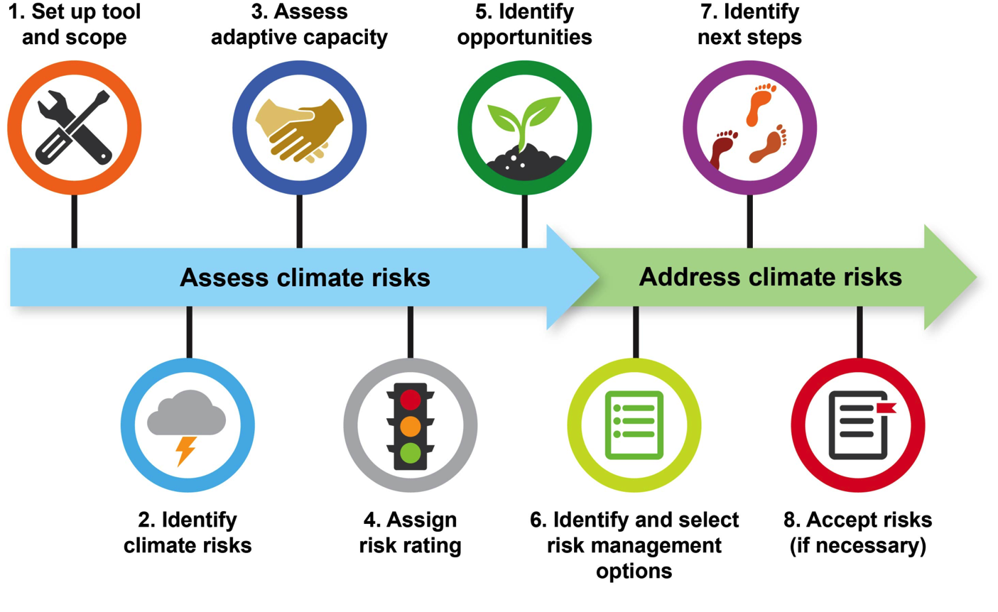
Where CRVA Fits In
1. Identify preliminary list of actions and develop CRVA
2. Summarize draft actions
3. Narrow list of actions with Work Groups based on evaluation criteria
4. Cadmus analyzes priority actions
CRVA
Set up tool and scope
Assets, systems, and populations (20-30)
Identify climate risks
Assess risk / vulnerability rating
Assess adaptive capacity
Prioritize assets, systems, and populations (15-20)
Present findings to Adaptation and Resiliency Work Group

Slide 39



Reference Plans
The following plans will be leveraged as part of the CRVA process

Slide 40
Resilience Vs. Adaptation
But back to WHAT?
Resilience
  Capacity of systems to “bounce back” and recover from shock or stress.
    Systems – infrastructure
    Social – at-risk groups
    Environmental
Adaptation
  An intervention which addresses the impacts of climate change and helps assets, systems, and populations be better able to adjust and cope with the negative results of climate change.

Slide 41
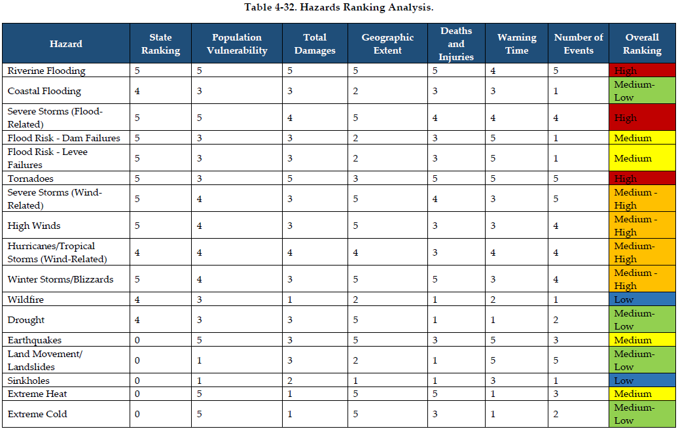
Top Climate Hazards / Risks
Source: Prince Georges County HMP

Slide 42
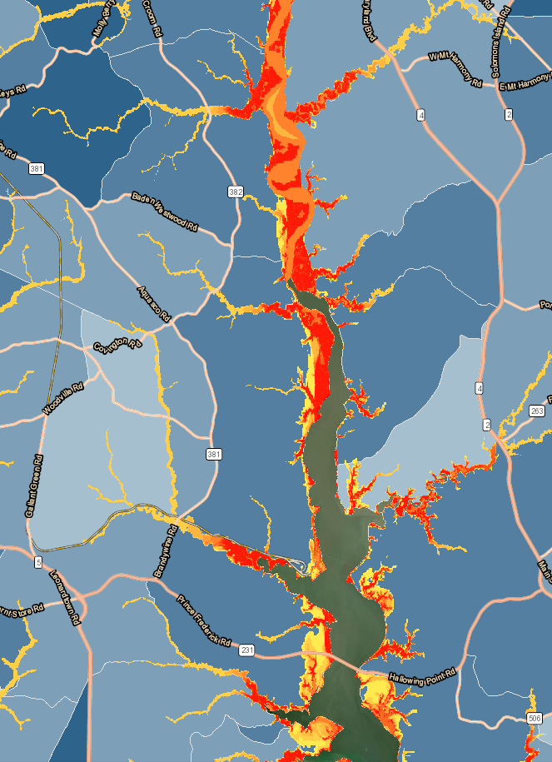
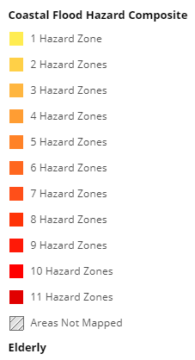
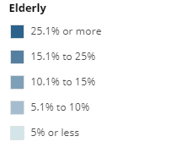
Flooding Focus
Riverine flooding identified as a top hazard by Prince George’s Co. HMP (2017)
‘Nuisance’ flooding studies by local non-profit Low Impact Development Center (LIDC) will also inform our work:
Includes tidal-influenced flooding and inland flooding
Sources are primarily tidal gauge information, National Oceanic and Atmospheric Administration (NOAA) Sea Level Rise viewer, NOAA Coastal Flood Exposure Tool
Tidal (Phase 1) – end of Dec. 2020
Inland (Phase 2) – spring 2021
Patuxent River
Flood hazard + elderly overlay along Patuxent River. > Source: NOAA Coastal Flood Exposure Tool

Slide 43
Factors To Consider
To help us prioritize top 15-20 assets, systems, & populations we will consider:
Assets, systems, and populations to be examined
Top hazards
Past impacts
Future impacts / projections
Risk
Vulnerability
Adaptive capacity
Additional Considerations

Slide 44
Next Steps
Adaptation Work Group meeting #1 (January)
  Present initial results of CRVA
  Discuss CRVA factors to be considered
  Discuss initial resilience and adaptation priorities
  Brainstorm initial resilience and adaptation actions
CRVA workshop
  Work with County staff to determine workshop participants
  Ground-truth the initial findings of the CRVA + identify gaps
  Prioritize the top three (3) hazards
  Narrow the list of at-risk assets, systems, and populations from 20-30 to 15-20
  Develop a common understanding of the climate vulnerabilities, risks, and top items to inform the resilience and adaptation actions.

Slide 45
Next steps, continued
Adaptation Work Group Meeting #2
  Reinforce the common understanding of the climate vulnerabilities and risks from the CRVA Workshop.
  Discuss initial resilience and adaptation actions
Adaptation Work Group Meeting #3
  Narrow down the list of resilience and adaptation actions for review and approval by the Commission

Slide 46
Questions?

Slide 47
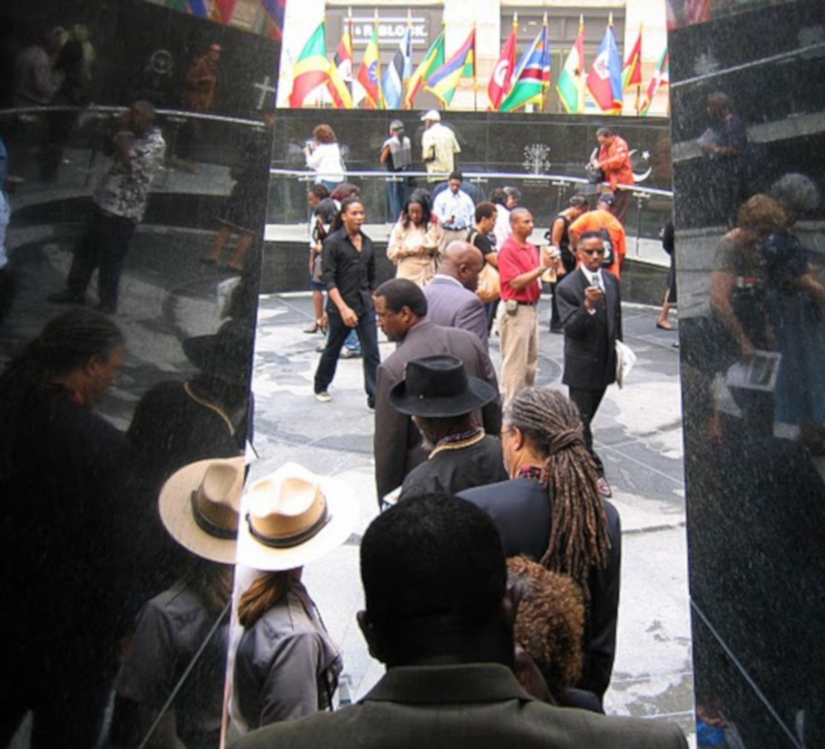

Justice & Sustainability Associates, LLC
Prince George's County Climate Action Commission Meeting
December 18, 2020

Slide 48
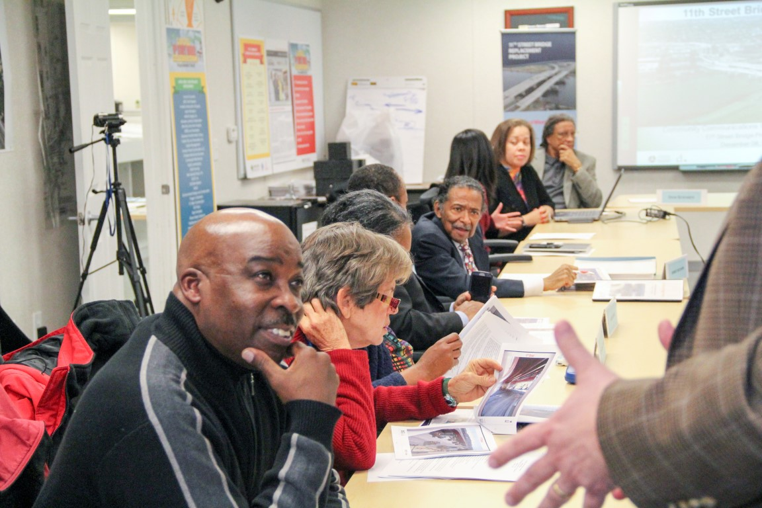
About JSA
Justice & Sustainability Associates, LLC (JSA) is an alternative dispute resolution firm founded in 1999 in the District of Columbia. JSA uses alternative dispute resolution and conflict management techniques in public policy, civic engagement, and organizational development processes centered around land use and development. To achieve both justice and sustainability, we put people first. The foundation of our consensus-based practices ensures all stakeholders have both an empowered voice and an informed seat at the decision-making table.
Our core driver is to increase justice and sustainability in material and measurable ways. We seek to help create more “Beloved Communities” wherever it works.

Slide 49

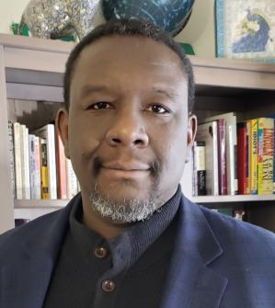
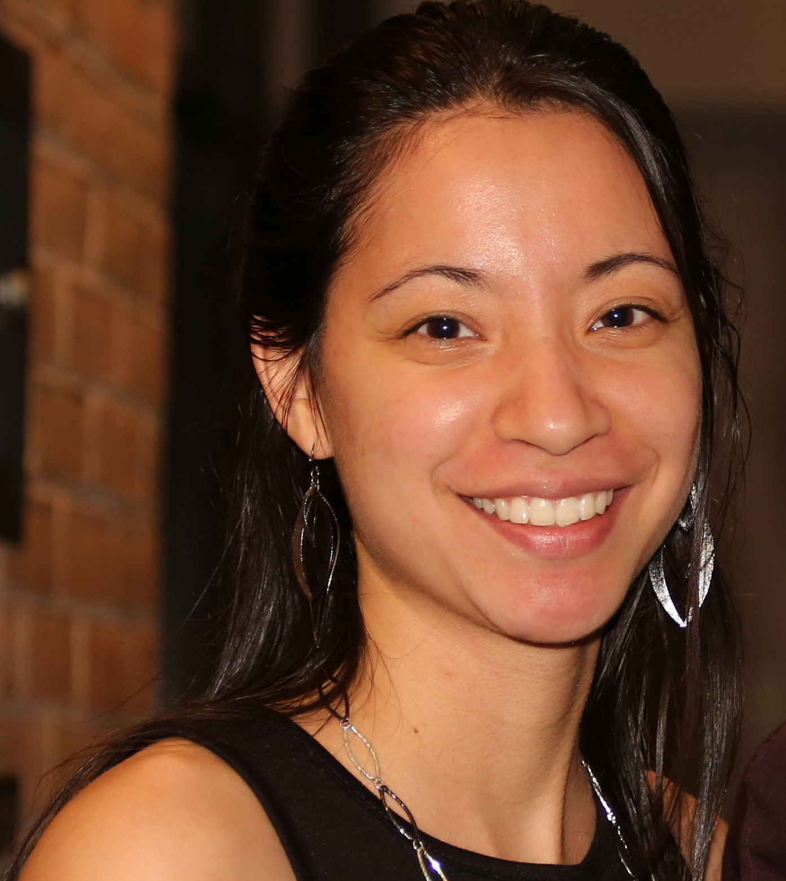
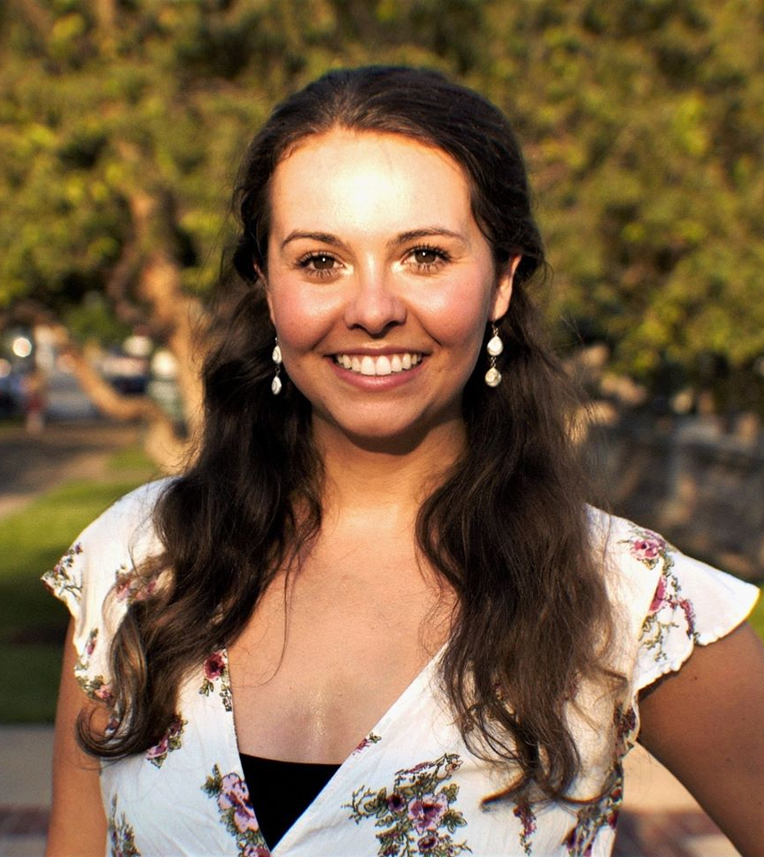

JSA Consultant Team
Donzell Robinson| COO & Principal
Project Lead, Strategic Advisement
Kayla Elson| Associate
Process Design, Project Management
Ingrid Eck| Project Coordinator
Communications, Logistics

Slide 50




Pillars of Engagement
PLANNING
GROUNDING
COLLABORATION
CAPACITY-BUILDING
Process Design
The planning strategic and tactical actions to meet a project’s desired results (e.g. project roadmap).
Communications, Engagement & Consensus Plan
A framework to produce an inclusive, transparent and participatory process.
Stakeholder Mapping & Conflict Assessment
An initial assessment involving a broad range of stakeholders.
Research, Documentation & Evaluation
A research and evaluative framework executed to ensure data-driven processes and success metrics.
Equitable Partnership
A multi-stakeholder forum for sharing information, collaborative planning, and consensus building.
Community Consultative Process
A series of stakeholder meetings designed for the equitable participation and inclusion of a broad array of residents and stakeholders.
Communications, Information & Education
Activities and collateral designed to augment communities’ intellectual capital about relevant issues.
Training
Capacity-building activities designed to augment participants’ human and social capital as relevant to the project.
Strategy
Advisement on policies and/or deliverables.

Slide 51
Stakeholder Engagement Matrix
WHO People unaware of the project or its impact on their lives. People who have no idea what the project is or why it matters. |  | WHO People already involved in issues but who don’t know about the project or how to help implement it. People who'd get involved in the project if they knew how to overcome a barrier to access (e.g., speak Spanish, no Internet access) |  | WHO People aware of the project but won't get involved because they don’t believe it will matter in their lives. People aware of the project but won't get involved because they don’t think it will be implemented. |  | WHO People who are already involved in the development of the project (e.g., local government representatives, “citizen planners”, developers) People who are aware of the project and know how to be fully engaged.
WHAT THEY NEED The most interesting & engaging facts How the Plan affects their lives Multiple and diverse channels of outreach/education Interactive and educational content Usability & accessibility |  | WHAT THEY NEED Accessibility (information they need) Usability (know how to find it/use it) Multiple ways to get involved Multiple & diverse channels of outreach/education |  | WHAT THEY NEED Details about process and outcomes Evidence of an inclusive public participation process Evidence that public comments are being recorded and used An understanding of the plan's scope Multiple ways to get involved Usability and accessibility |  | WHAT THEY NEED Lots of details! Multiple ways to get involved An understanding of the plan's scope Evidence that public comments are being recorded and used Usability & accessibility
QUADRANT 1: Not Informed, Interested or Engaged (What is the Project?) |  | QUADRANT 2: Not Informed but Interested/ Want to Be Engaged (How can I get involved?) |  | QUADRANT 3: Well- Informed But Unwilling to Get Engaged (Why should I waste my time?) |  | QUADRANT 4: Well- Informed, Interested & Engaged (I can help!)
1
2
3
4

Slide 52
Stakeholder Engagement Matrix
QUADRANT 3: Well- Informed But Unwilling to Get Engaged (Why should I waste my time?) |  | QUADRANT 4: Well- Informed, Interested & Engaged (I can help!)
QUADRANT 1: Not Informed, Interested or Engaged (What is the project?) |  | QUADRANT 2: Not Informed but Interested/ Want to Be Engaged (How can I get involved?)
Informed
Engaged

Slide 53
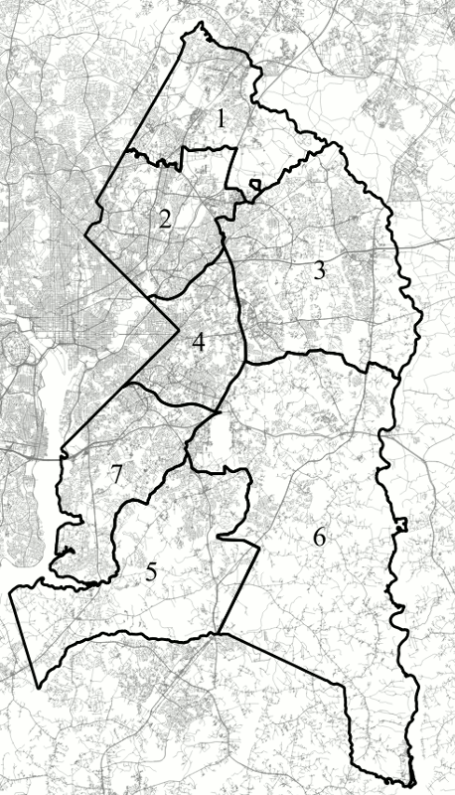
Engaging Prince George’s County
Understanding the impacts of different demographic compositions across the County will be key in establishing an actionable and equitable plan.
Population Density
Subregions 2 & 4 (both along beltway): highest median population densities
Other high-density areas: Laurel (subregion 1); Lanham-Seabrook, Bowie, Largo (subregion 3); Surratsville-Clinton (subregion 5); Upper Marlboro (subregion 6)
Median Household Income (Wealth)
Highest income: subregions 3, 5, and 6 - $100,000 - $110,000 annually
Lowest income: subregions 2 & 4 (inside beltway) - $60,000 annually but has wealthier pockets
Source: DW Rowlands

Slide 54
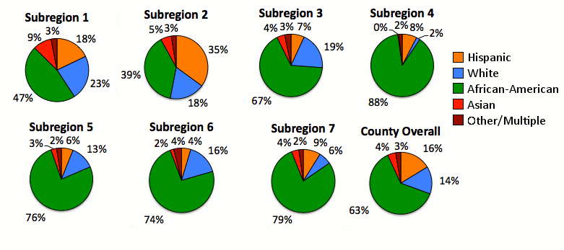
Engaging Prince George’s County
As we engage the community in this process, it is important to consider the implications of racial demographics.
Source: DW Rowlands

Slide 55
JSA Deliverables
Stakeholder Mapping & Analysis
Development & implementation of engagement strategy (including virtual open house)
Facilitation of Education, Communication and Outreach Work Group (3 meetings)
Design & facilitation of three public meetings

Slide 56

Effective & Equitable Engagement Strategy
Virtual engagement toolkit, including Virtual Open House
Timely, consistent, advanced, proactive communication among COG, neighborhoods, environmental organizations, schools, and other stakeholders
Coordination with Commission, Work Groups, and key partners
Consistent project narrative/messaging
Accessible collateral development and use of website and social media platforms

Slide 57

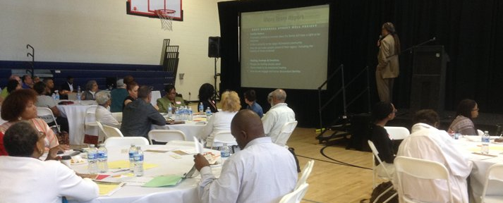

Questions?

Slide 58
Next Steps
County + Consulting Team
  Distribute survey to Commissioners to establish January Work Group meetings dates/times
  Prepare to facilitate discussions at January Work Group meetings
  Conduct GHG emissions reduction scenarios analysis
  Continue work on Climate Risk and Vulnerability (CRVA) process
  Continue work on public engagement plan and develop initial list of outreach target groups and implementation partners

Slide 59
Next Steps Cont.
Next Commission Meeting is Friday, February 19. Potential agenda items to include:
  Discussion on GHG reduction target building off of January Mitigation Work Group meeting
  Review and discuss initial list of mitigation + adaptation actions from January Adaptation Work Group and Mitigation Work Group meetings
  Report back from Outreach Work Group on engagement plan and preparations for public meetings

Slide 60
Thank You / Q&A

